Slide 1




CS Bridge, Lecture 1 Welcome to CS Bridge!

Slide 2
Welcome to CS Bridge!
We are here to share with you our love for programming!
A joint effort
Our goal: form a community of people to learn and teach programming together
Notes:
300 students
>20 SLs
Once you learn something, you can teach others

Slide 3
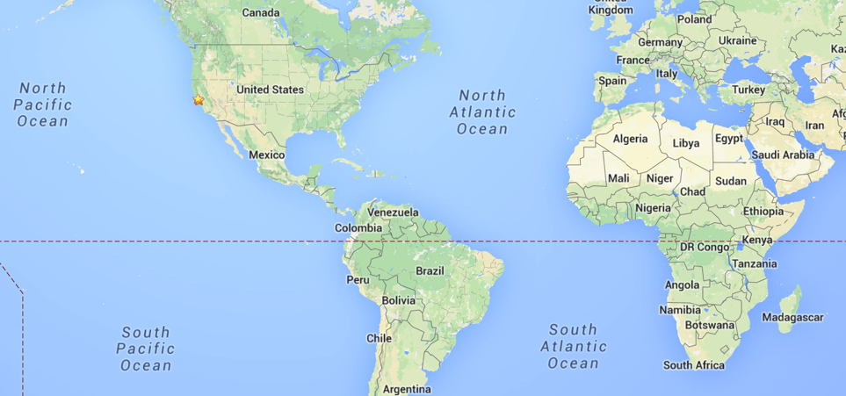
Bridging The World

Slide 4
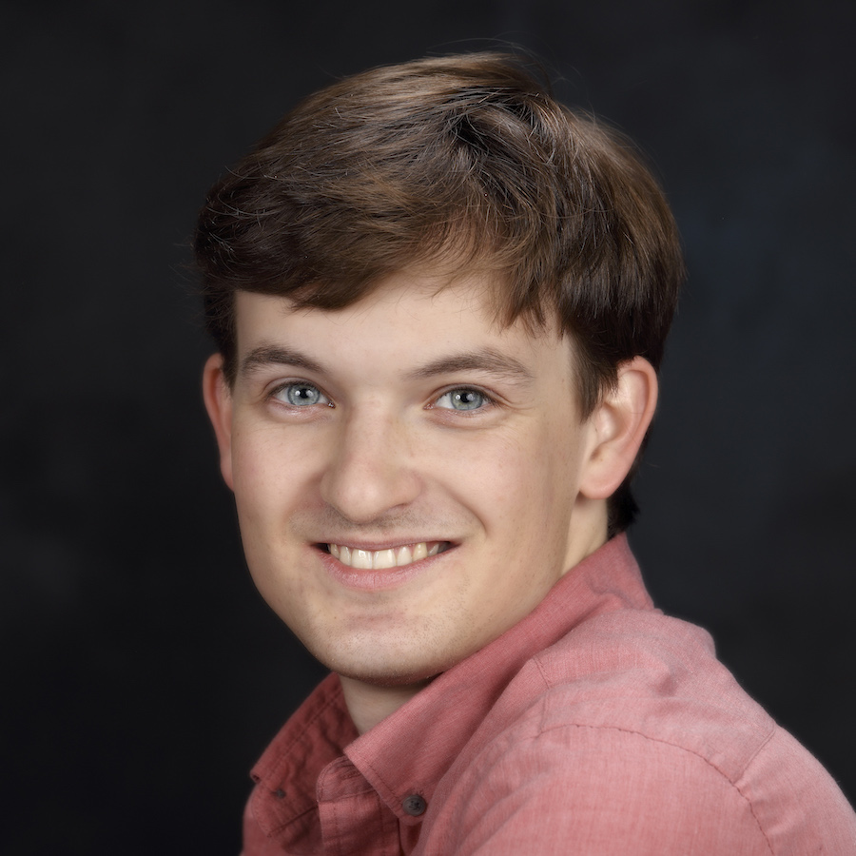
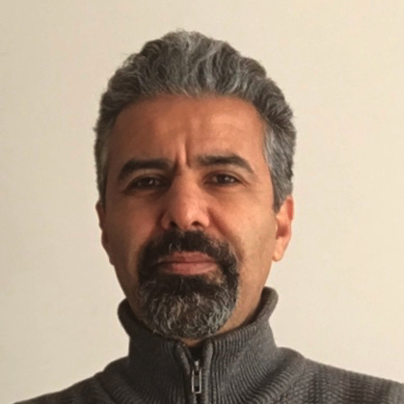

Nice to meet you!
Instructors:
Hi! I’m Nick.
Hi! I’m Barış.
Hi! I’m Buket.

Slide 5

Nice to meet you!
Head Of CS Bridge:
Hi! I’m Chris.

Slide 6

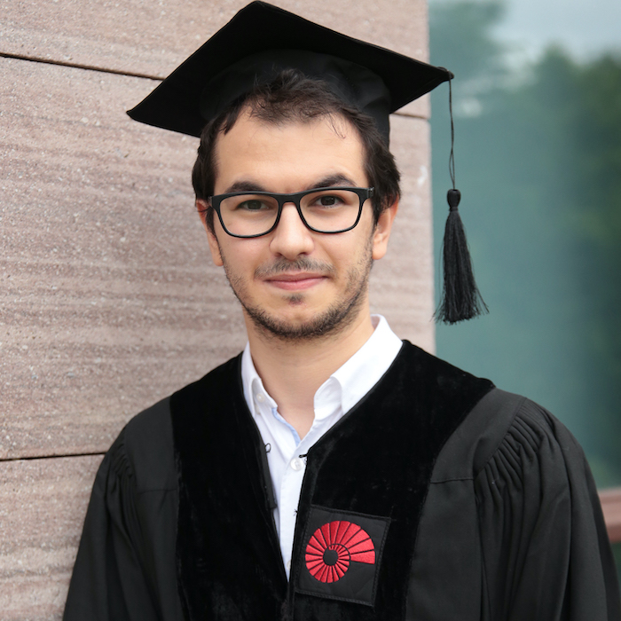
Nice to meet you!
Head Section Leaders:
Hi! I’m Irem.
Hi! I’m Ahmet.

Slide 7
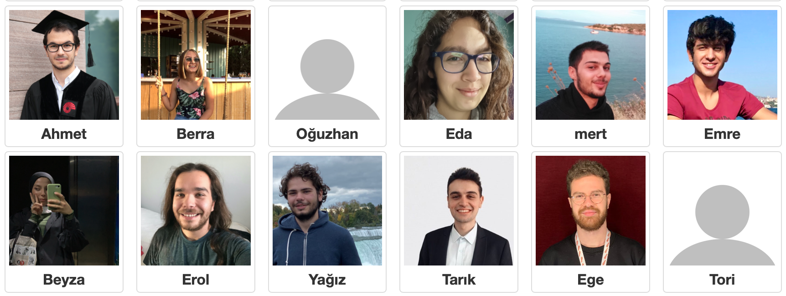
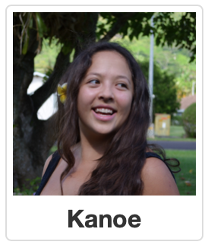
Nice to meet you!
Section Leaders:

Slide 8
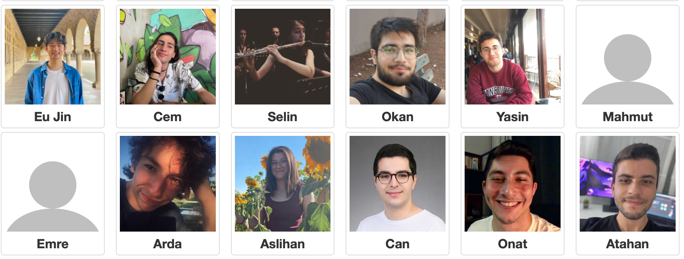
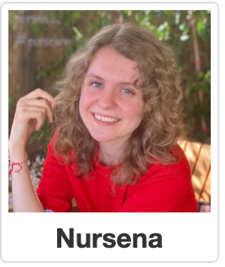
Nice to meet you!
Section Leaders:

Slide 9

Lecture Plan
Welcome to CS Bridge!
Course information
Meet Karel the Robot
Defining new commands
For loops

Slide 10
Lecture Plan
Welcome to CS Bridge!
Course information
Meet Karel the Robot
Defining new commands
For loops

Slide 11
CS Bridge on Zoom
You are encouraged to share video!
Post questions/comments/follow-ups in the Zoom chat. We’ll take periodic “question breaks” to address them and have teachers monitoring the chat during the lecture. Everyone is muted by default.

Slide 12
Course Website
turkey21.csbridge.org

Slide 13
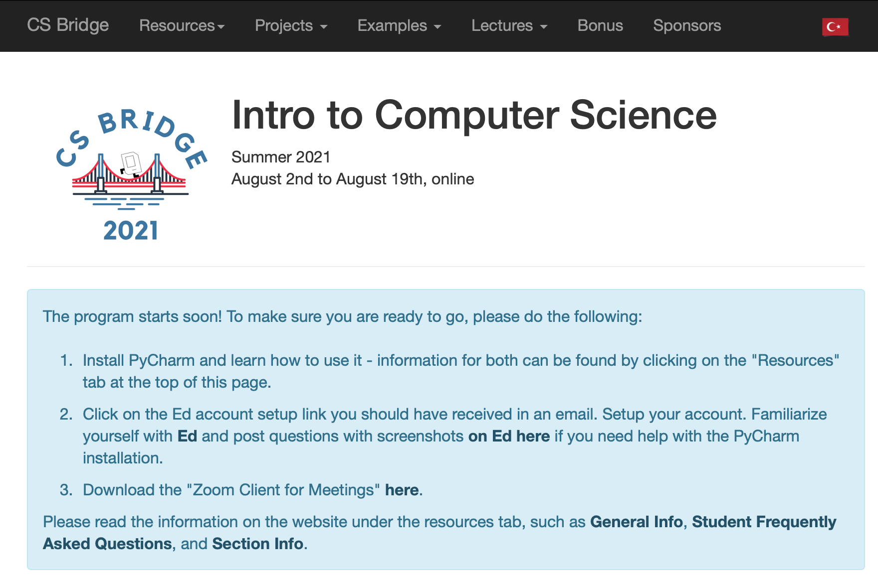
The Website Tells You Where To Go!

Slide 14
Ed Forum
We are using a website called Ed for asking and answering questions.
You can post questions there, and we or other students can answer them.
If you haven’t already, check your email for your invite to join Ed.
2 Ed Groups:
CS Bridge (main group)
Your Section

Slide 15
CS Bridge Structure – Learn By Doing
Lecture – Where we introduce new concepts!
Quickstart / Tea Time – Right after each lecture with your section group. Time for you to play around with the material on your own computers and mingle with other students.
Section – Right after evening quickstart, with your section group. You will work as a group with your Section Leader to solve practice problems.
Office Hours / Work – Right after the morning quickstart and the evening section. Your own time to work on the projects and get group help from students and Section Leaders or individual help from the Section Leaders.
At the end of the morning and evening segments, submit your work!

Slide 16
Nooks Office Hours
We are using a website called Nooks for student “office hours”
Like Zoom, but you can see all rooms, jump between rooms depending on what you are working on, and sign up in a queue for 1 on 1 help.
You can join Nooks via a link on the course website.

Slide 17
Section Leader
Section Leaders will…
Lead your daily section and quickstart times
Help you when you have questions in Office Hours and on Ed
And much more…
Notes:
Take advantage of them!

Slide 18
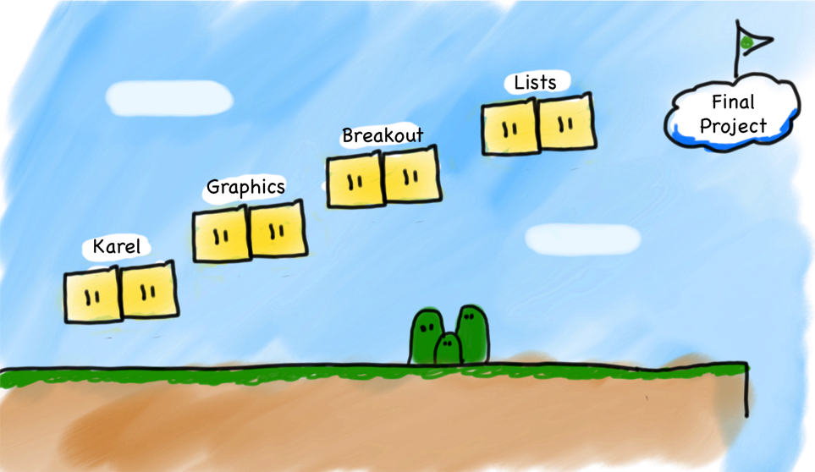
What Will We Learn?
Breakout
Graphics
Console
Karel
Notes:
Same material as Stanford’s class

Slide 19
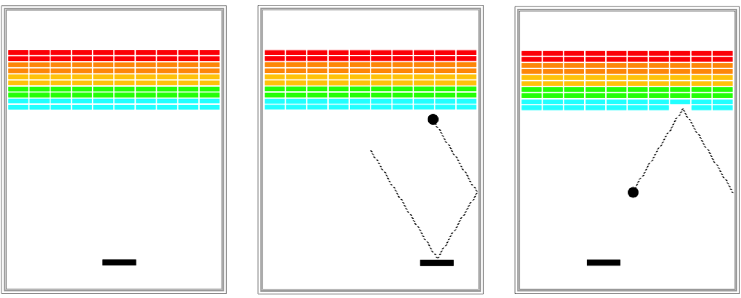
Breakout

Slide 20
Prerequisites
None! We assume you have never programmed before.

Slide 21
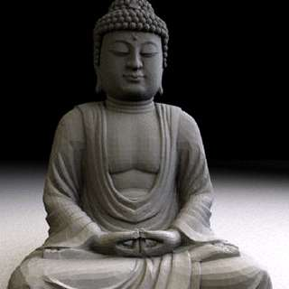
Art Of Computer Science
CS Bridge covers software engineering principles – much more than just programming
Writing a program is like writing an essay
Need a language (Python)
But just knowing the language doesn’t make you a good essay writer
Programming is a tool you can use to do amazing things!

Slide 22
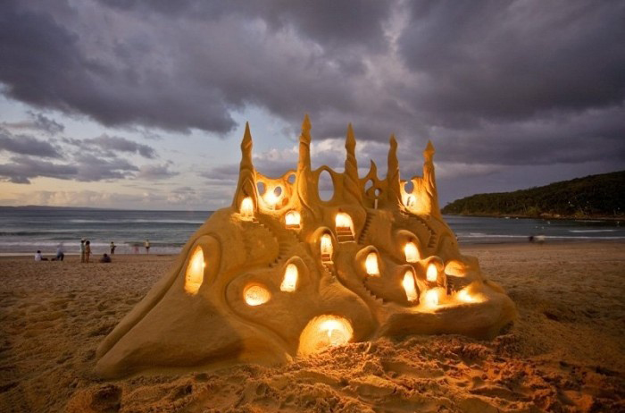
The Joy Of Building

Slide 23

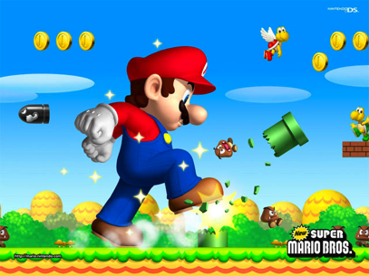

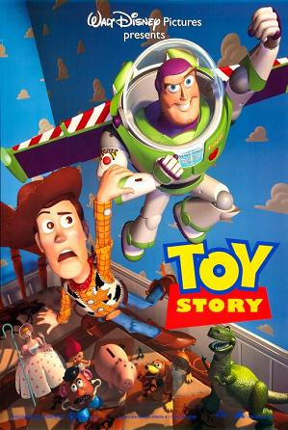
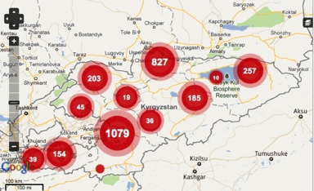
The Joy Of Building

Slide 24
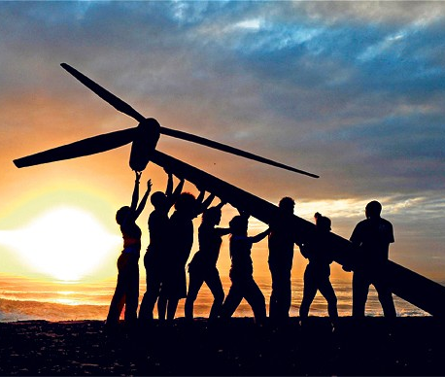
Strive For Everyone To Succeed
We want all of you to be successful!
You are not competing against anyone but yourself.
Learning programming is hard! We are here to help you. Please post on Ed, come to Office Hours or talk to your Section Leader if you are having trouble.
Your most important task: show up!

Slide 25
Lecture Plan
Welcome to CS Bridge!
Course information
Meet Karel the Robot
Defining new commands
For loops

Slide 26
Meet Karel the Robot!
Notes:
Karel – from Karel Chopek, who invented the word “robot”
Old Mac with leg out its back

Slide 27
Meet Karel the Robot!
Hello!
¡Hola!
Merhaba!
Ahoj!
Notes:
Karel speaks Java! (not english)

Slide 28
Meet Karel the Robot!
Notes:
Karel speaks Java! (not english)

Slide 29
Karel's World
3
.
.
.
.
.
2
.
.
.
.
.
1
.
.
.
.
.
1
2
3
4
5

Slide 30

Karel's World
3
.
.
.
.
.
2
.
.
.
.
.
1
.
.
.
.
.
1
2
3
4
5

Slide 31
Karel's World
3
.
.
.
.
.
2
.
.
.
.
.
Hello, world!
1
.
.
.
.
.
1
2
3
4
5

Slide 32
Karel's World
3
.
.
.
.
.
2
.
.
.
.
.
1
.
.
.
.
.
1
2
3
4
5

Slide 33
Streets (rows)
3
.
.
.
.
.
2
.
.
.
.
.
1
.
.
.
.
.
1
2
3
4
5
Each row is called a street.

Slide 34
Avenues (columns)
3
.
.
.
.
.
2
.
.
.
.
.
1
.
.
.
.
.
1
2
3
4
5
Each column is called an avenue.

Slide 35
Corners (locations)
3
.
.
.
.
.
2
.
.
.
.
.
1
.
.
.
.
.
The intersection of a street and an avenue is a corner.
1
2
3
4
5

Slide 36
Walls
3
.
.
.
.
.
2
.
.
.
.
.
1
.
.
.
.
.
1
2
3
4
5
Karel cannot move through walls.

Slide 37
Beepers
3
.
.
.
.
.
2
.
.
.
.
.
1
.
.
.
.
.
Beepers mark locations in Karel's world. Karel can pick them up and put them down.
1
2
3
4
5

Slide 38
Karel Knows 4 Commands
move
turn_left
put_beeper
pick_beeper
Notes:
Don’t be deceived! Build complex things from simple commands

Slide 39
Karel Knows 4 Commands
move
turn_left
“functions”
put_beeper
pick_beeper

Slide 40
Commands: move
move makes Karel move forward one square in the direction it is facing.
Karel Commands
3
.
.
.
.
.
move
turn_left
pick_beeper
put_beeper
2
.
.
.
.
.
1
.
.
.
.
.
.
1
2
3
4
5

Slide 41
Commands: move
move makes Karel move forward one square in the direction it is facing.
Karel Commands
3
.
.
.
.
.
move
turn_left
pick_beeper
put_beeper
2
.
.
.
.
.
1
.
.
.
.
.
.
1
2
3
4
5

Slide 42
Commands: turn_left
turn_left makes Karel rotate 90° counter-clockwise.
There is no turn_right command.
Karel Commands
3
.
.
.
.
.
move
turn_left
pick_beeper
put_beeper
2
.
.
.
.
.
1
.
.
.
.
.
.
1
2
3
4
5

Slide 43
Commands: turn_left
turn_left makes Karel rotate 90° counter-clockwise.
There is no turn_right command.
Karel Commands
3
.
.
.
.
.
move
turn_left
pick_beeper
put_beeper
2
.
.
.
.
.
1
.
.
.
.
.
.
1
2
3
4
5

Slide 44
Commands: pick_beeper
pick_beeper makes Karel pick up the beeper at the current corner. Karel can hold multiple beepers at a time in its "beeper bag".
Karel Commands
3
.
.
.
.
.
move
turn_left
pick_beeper
put_beeper
2
.
.
.
.
.
1
.
.
.
.
.
.
1
2
3
4
5

Slide 45
Commands: pick_beeper
pick_beeper makes Karel pick up the beeper at the current corner. Karel can hold multiple beepers at a time in its "beeper bag".
Karel Commands
3
.
.
.
.
.
move
turn_left
pick_beeper
put_beeper
2
.
.
.
.
.
1
.
.
.
.
.
.
1
2
3
4
5

Slide 46
Commands: put_beeper
put_beeper makes Karel put a beeper down at its current location.
pick_beeper and put_beeper are used to move beepers around.
Karel Commands
3
.
.
.
.
.
move
turn_left
pick_beeper
put_beeper
2
.
.
.
.
.
1
.
.
.
.
.
.
1
2
3
4
5
Notes:
beeper bag

Slide 47
Commands: put_beeper
put_beeper makes Karel put a beeper down at its current location.
pick_beeper and put_beeper are used to move beepers around.
Karel Commands
3
.
.
.
.
.
move
turn_left
pick_beeper
put_beeper
2
.
.
.
.
.
1
.
.
.
.
.
.
1
2
3
4
5
Notes:
beeper bag

Slide 48
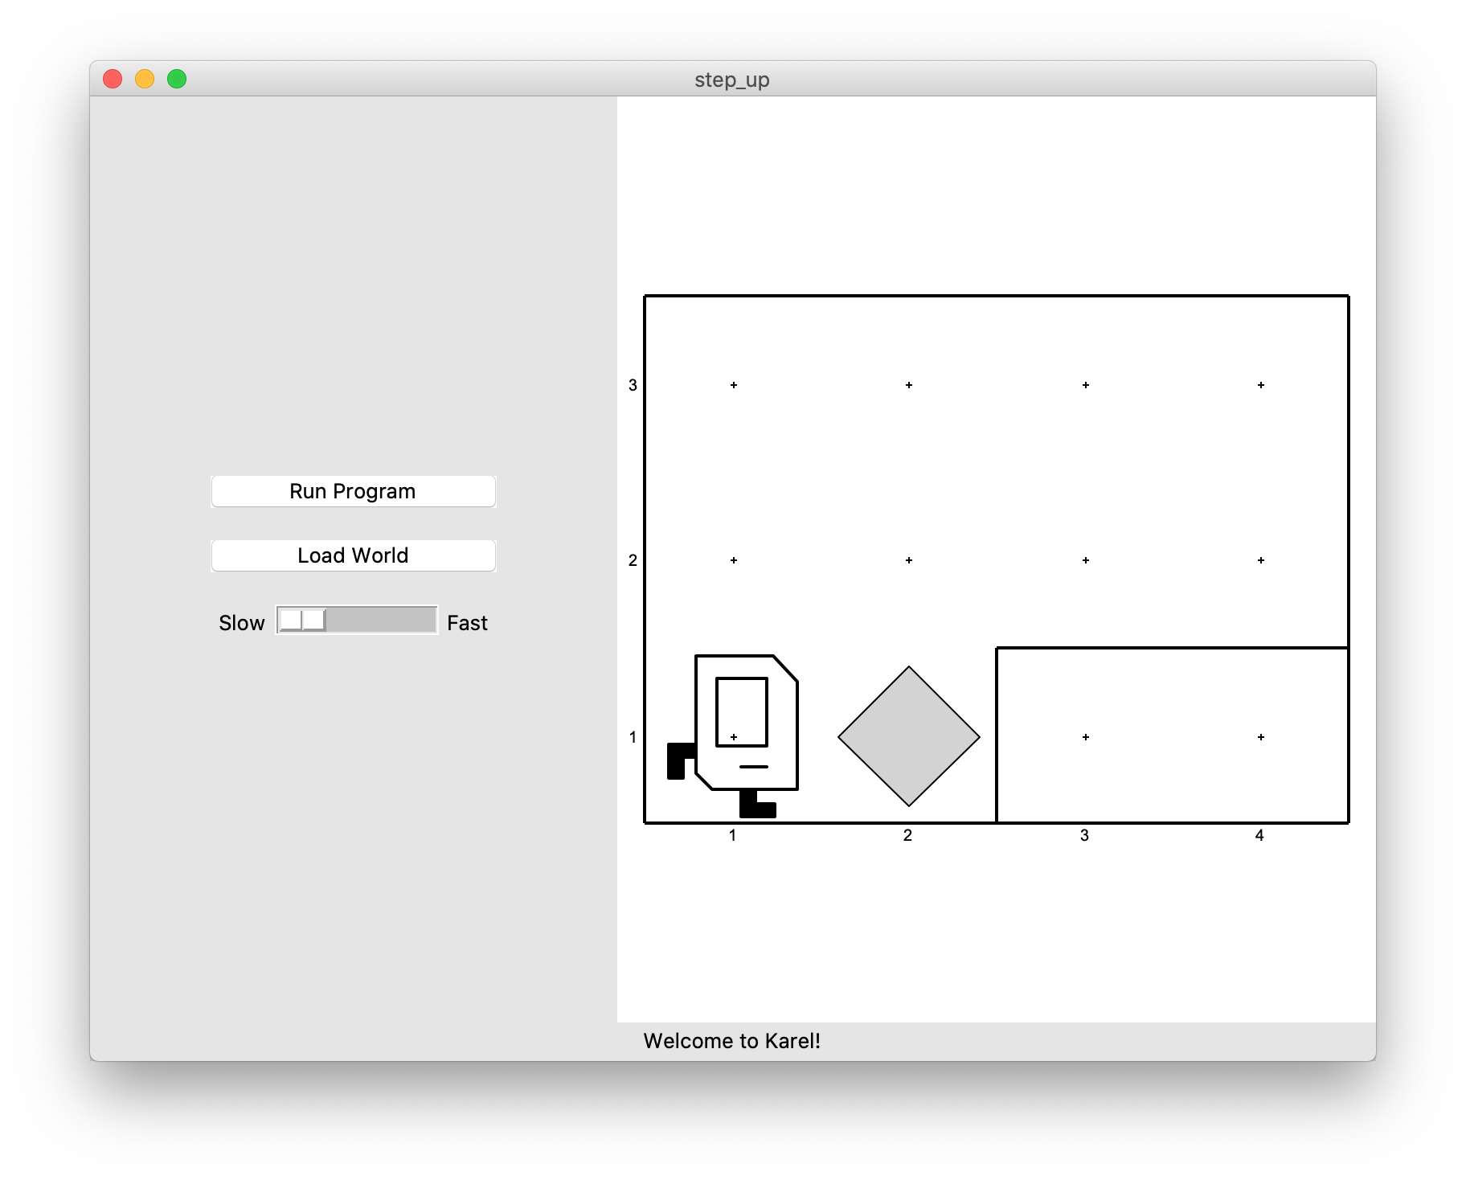
Our First Karel Program
Before:

Slide 49
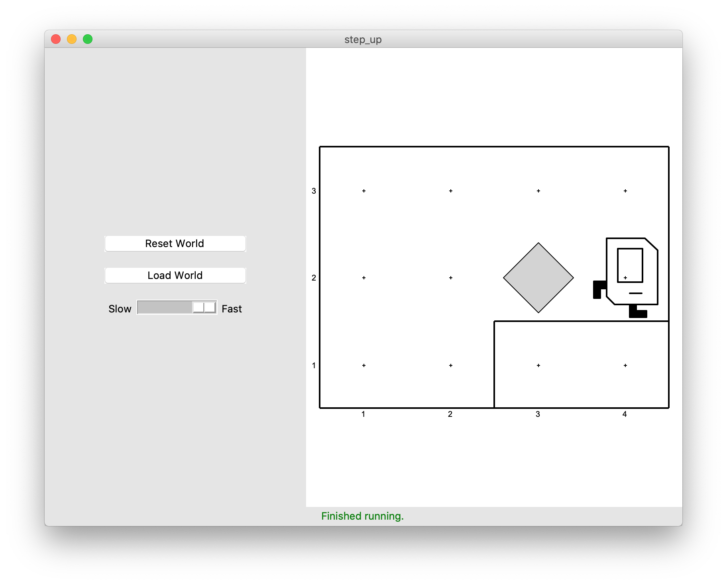
Our First Karel Program
After:

Slide 50
Demo
Notes:
Explain source code components
Karel commands
Main function
Comments
Runkarelprogram and import
Have milestones – get Karel halfway

Slide 51
Anatomy Of A Program
def main():
move()
pick_beeper()
move()
turn_left()
move()
turn_left()
move()
put_beeper()
move()
...
if __name__ == "__main__": run_karel_program()
This piece of the program's source code is called a function.

Slide 52
Anatomy Of A Program
def main():
move()
pick_beeper()
move()
turn_left()
move()
turn_left()
move()
put_beeper()
move()
...
if __name__ == "__main__": run_karel_program()
This line of code gives the name of the function
(here, main)

Slide 53
Anatomy Of A Program
def main():
move()
pick_beeper()
move()
turn_left()
move()
turn_left()
move()
put_beeper()
move()
...
if __name__ == "__main__": run_karel_program()
This is called a code block. Python requires that code blocks be indented one level.

Slide 54
Lecture Plan
Welcome to CS Bridge!
Course information
Meet Karel the Robot
Defining new commands
For loops

Slide 55
Defining New Commands
We can make new commands (or functions) for Karel. This lets us decompose our program into smaller pieces that are easier to understand.
def name():
statement
statement
...
For example:
def turn_right():
turn_left()
turn_left()
turn_left()
Notes:
Go back to Pycharm and show solution with turnright

Slide 56
Decomposition
Breaking down problems into smaller, more approachable sub-problems (e.g. our own Karel commands)
Each piece should solve one problem/task (< ~ 20 lines of code)
Descriptively-named
Well-commented!
E.g. getting up in the morning:
Wake up
Brush teeth
Put toothpaste on toothbrush
Insert toothbrush into mouth
Move toothbrush against teeth
…
…

Slide 57
Top-Down Design
Start from a large task and break it up into smaller pieces
Goal: make our programs easily readable by humans
Commenting
Decomposition

Slide 58
Lecture Plan
Welcome to CS Bridge!
Course information
Meet Karel the Robot
Defining new commands
For loops

Slide 59
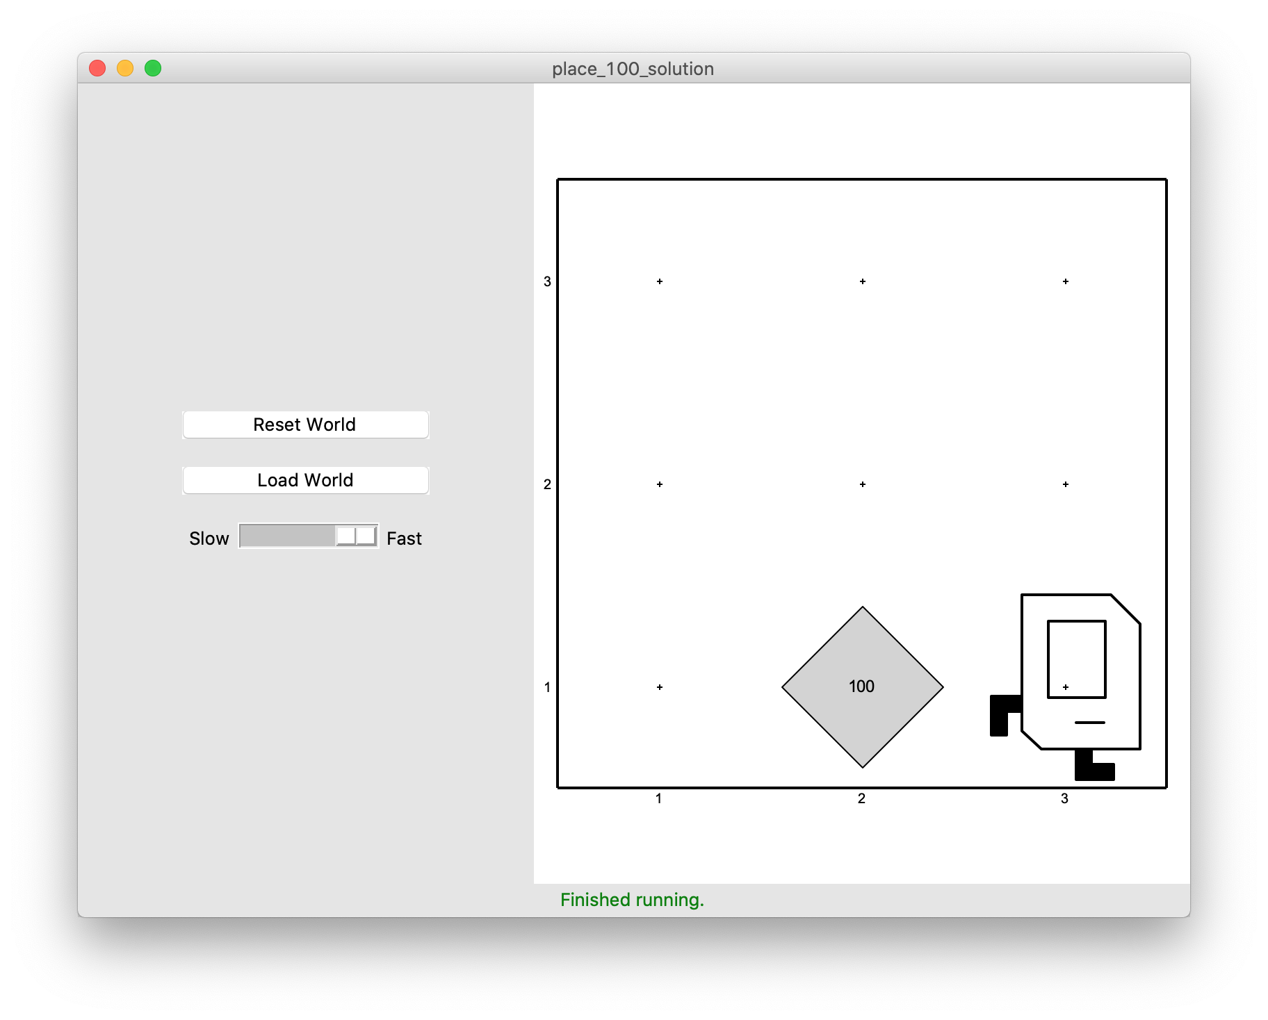
For Loops
I want to make Karel put 100 beepers down on a corner. How do I do this?

Slide 60
For Loops
Can’t just say:
move()
put_beeper()
put_beeper()
put_beeper()
...
move()
This is too repetitive! Plus, it’s difficult to change (e.g. to 25 beepers).

Slide 61
For Loops
Instead, use a for loop:
for i in range(count):
statement
statement
...
Repeats the statements in the body count times.
Notes:
Executes statements in order – NOT repeating each one individually

Slide 62
For Loops
Now we can say:
move()
for i in range(100):
put_beeper()
move()
This is less repetitive and is easier to change (e.g. to 25 beepers).
Notes:
DEMO in PyCharm

Slide 63
For Loops and Indentation
for i in range(count):
statements # note indenting
def turn_right():
for i in range(3):
turn_left() # note indenting

Slide 64
Lecture Plan
Welcome to CS Bridge!
Course information
Meet Karel the Robot
Defining new commands
For loops

Slide 65
Welcome to CS Bridge!
We are here to share with you our love for programming!
A joint effort
Our goal: form a community of people to learn and teach programming together
Notes:
300 students
>20 SLs

Slide 66
What’s Next?
Time for your section’s quickstart time!
Check your section’s Ed group for more information
We hope you will be able to get set up if you aren’t already, and complete at least collect newspaper Karel. Have fun!

Slide 67
Extra: Beeper Square

Slide 68

For Loop Example: Beeper Square
def main(): for i in range(4): put_beeper() move() turn_left()

Slide 69
For Loop Example: Beeper Square
def main(): for i in range(4): put_beeper() move() turn_left()

Slide 70
For Loop Example: Beeper Square
def main(): for i in range(4): put_beeper() move() turn_left()
First time through the loop

Slide 71

For Loop Example: Beeper Square
def main(): for i in range(4): put_beeper() move() turn_left()
First time through the loop

Slide 72
For Loop Example: Beeper Square
def main(): for i in range(4): put_beeper() move() turn_left()
First time through the loop

Slide 73
For Loop Example: Beeper Square
def main(): for i in range(4): put_beeper() move() turn_left()
First time through the loop

Slide 74
For Loop Example: Beeper Square
def main(): for i in range(4): put_beeper() move() turn_left()
Second time through the loop

Slide 75
For Loop Example: Beeper Square
def main(): for i in range(4): put_beeper() move() turn_left()
Second time through the loop

Slide 76
For Loop Example: Beeper Square
def main(): for i in range(4): put_beeper() move() turn_left()
Second time through the loop

Slide 77
For Loop Example: Beeper Square
def main(): for i in range(4): put_beeper() move() turn_left()
Second time through the loop

Slide 78
For Loop Example: Beeper Square
def main(): for i in range(4): put_beeper() move() turn_left()
Third time through the loop

Slide 79
For Loop Example: Beeper Square
def main(): for i in range(4): put_beeper() move() turn_left()
Third time through the loop

Slide 80
For Loop Example: Beeper Square
def main(): for i in range(4): put_beeper() move() turn_left()
Third time through the loop

Slide 81
For Loop Example: Beeper Square
def main(): for i in range(4): put_beeper() move() turn_left()
Third time through the loop

Slide 82
For Loop Example: Beeper Square
def main(): for i in range(4): put_beeper() move() turn_left()
Fourth time through the loop

Slide 83
For Loop Example: Beeper Square
def main(): for i in range(4): put_beeper() move() turn_left()
Fourth time through the loop

Slide 84
For Loop Example: Beeper Square
def main(): for i in range(4): put_beeper() move() turn_left()
Fourth time through the loop

Slide 85
For Loop Example: Beeper Square
def main(): for i in range(4): put_beeper() move() turn_left()
Fourth time through the loop

Slide 86
For Loop Example: Beeper Square
def main(): for i in range(4): put_beeper() move() turn_left()
Done!

